Slide 1
Theory Building
Dirk Riehle, Univ. Erlangen
NYT C01
Licensed under CC BY 4.0 International

Slide 2
Agenda
Theory building
Qualitative research
Example methodologies
Multi-method research
Mixed-methods research
Quality assurance

Slide 3
1. Theory Building

Slide 4
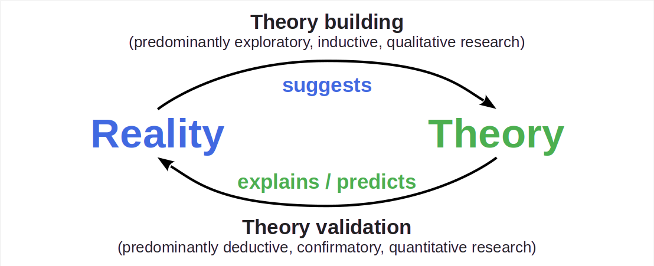
The Logic and Process of Science (Recap)

Slide 5
Purpose of Theory Building
The purpose of scientific theory building is to
Create, build out, and evaluate a theory that
Correctly explains and/or predicts reality
Can can be continuously tested
In a cost-efficient way

Slide 6
Types of Research Questions Answered
Explanatory questions like how, why?
Questions that lead to a theory
Not: Whether something is the case

Slide 7
Theory Building Research
Theory building research is
Exploratory
Inductive
Qualitative

Slide 8
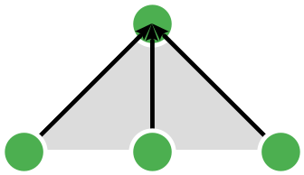
Inductive Reasoning
Inductive research is based on inductive reasoning which is
Abstracting from data by recognizing patterns and drawing conclusions

Slide 9
Theory Building Process
The theory building process
Is iterative
Is incremental
Mitigates risk
Never ends

Slide 10
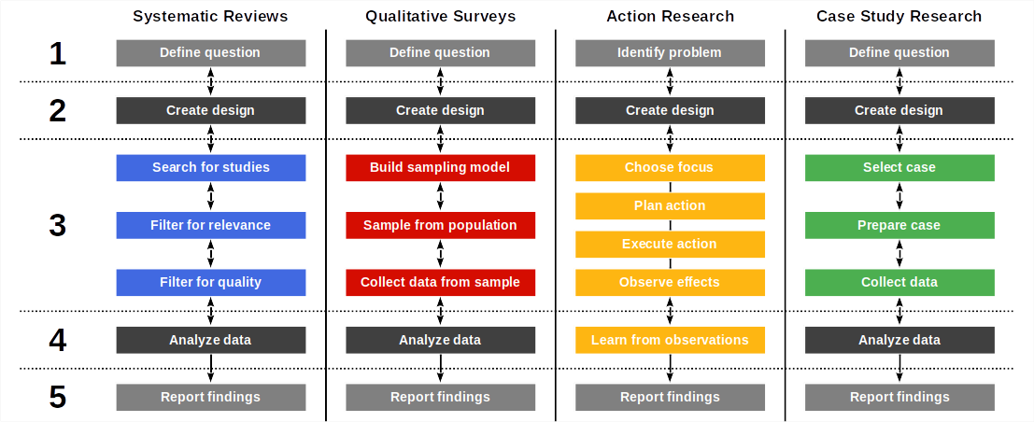
Theory Building Processes by Methodology

Slide 11
What Makes a Good Theory? [1]
Testability
The degree to which empirical refutation is possible
Empirical support
The degree to which empirical studies support the theory
Explanatory power
The degree to which all known observations can be explained
Parsimony
The theory’s simplicity
Generality
The theory breadth and width
Utility
The theory applicability
[1] See Sjoberg et al. (2008): Building theories in software engineering

Slide 12
2. Qualitative Research

Slide 13
Base Terminology (Recap)
Researchers use a research methodology
Recap: A start-to-finish framework for performing theory building
To create a research design
Recap: A process description for answering a research question
That utilizes research methods
Recap: A method answering a type of research question
Which combine research practices
Recap: A way of doing something with a defined outcome

Slide 14
What Makes a Research Design a Qualitative Design?
The theory building purpose
The use of theoretical sampling in data collection
The acquisition and use of qualitative data

Slide 15
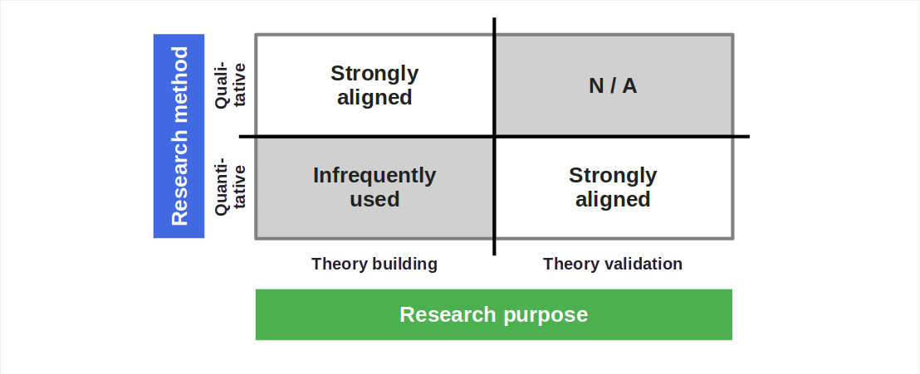
Qualitative vs. Quantitative Research Methods (Recap)

Slide 16
Example Qualitative Research Methodology (Recap)
The qualitative survey according to Jansen (2010)
Write research protocol
Build sampling model
Sample for theory building
Perform interviews
Analyze transcriptions
Determine saturation
Iterate or conclude

Slide 17
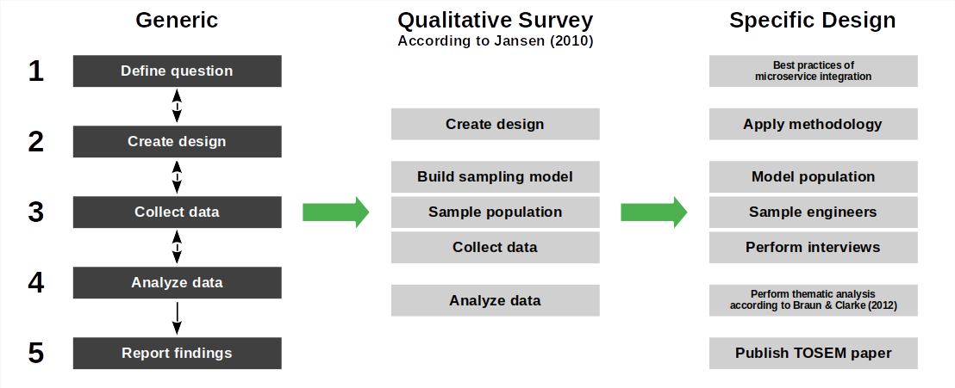
Example Research Design Refinement

Slide 18
3. Example Methodologies

Slide 19
Research Methodologies
Main categories
Systematic survey [1]
Qualitative survey [2]
Action research
Case study research
Grounded theory
Ethnographies
Not a methodology
Introspection
[1] Most commonly: Literature survey
[2] Most commonly: Interview study

Slide 20
Action Research
Action research is a research methodology in which the researcher
Applies a theory being built to help create a desired outcome
Evaluates the theory as to its trustworthiness
Participatory action research is action research in which the researcher
Joins a case (organization) to work side-by-side with practitioners

Slide 21
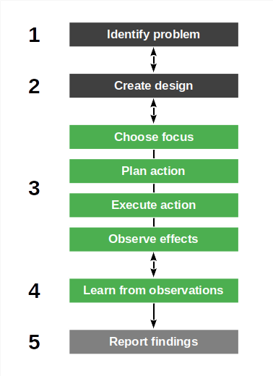
The Action Research Process
Identify (research) problem
Create research design
Perform action
Choose focus
Plan action
Execute action
Observe effects
Learn from observations

Slide 22
Example Action Research Methodologies
Lewin (1946): Action research
McIntyre (2007): Participatory action research
Kemmis et al. (2014): Critical participatory action research

Slide 23
Case Study Research
Case study research is a research methodology in which the researcher
Investigates a (contemporary) phenomenon it its original context
Where the boundaries between phenomenon and context are blurry

Slide 24
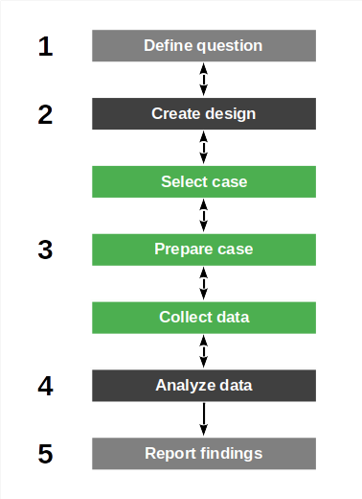
Case Study Research Process
Define research question
Create research design
Iterate over
Select case
Prepare case
Collect data
Analyze data
Report findings

Slide 25
Example Case Study Research Methodologies
Eisenhardt (1989): Case study research
Yin (2009): Case study research
Runeson et al. (2012): Case study research in software engineering

Slide 26
Research Paradigms
Analytical research
Research is detached; goal is understanding
Action research [1]
Research is involved; goal is improving
Design science research
Research is applied; goal is innovation
[1] Using the same name for research paradigm and methodology category

Slide 27
4. Multi-Method Research

Slide 28
Multi-Method(ology) Research Designs
A multi-method research design is a research design that
Uses multiple methodologies and methods
Within either theory building or validation research

Slide 29
Example Multi-Method Research Design
Best practices of microservices integration
Theory creation
Jansen (2010): The qualitative survey
Theory build-out
Baskerville & Harper (1996): Participatory action research
Theory evaluation
Runeson & Höst (2009): Case study research

Slide 30
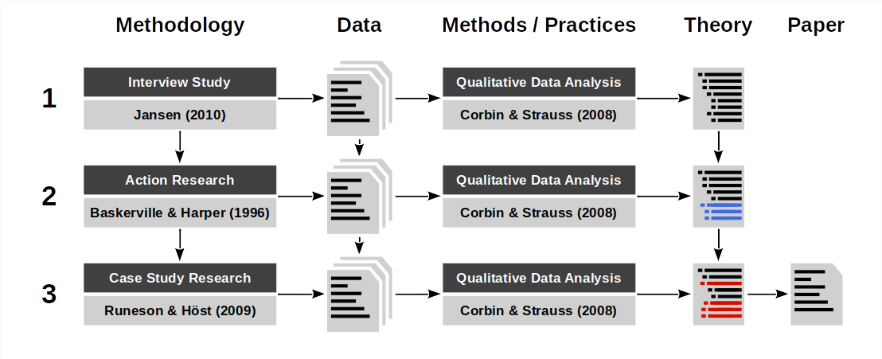
Theory Building and Triangulation Using Multiple Methods

Slide 31
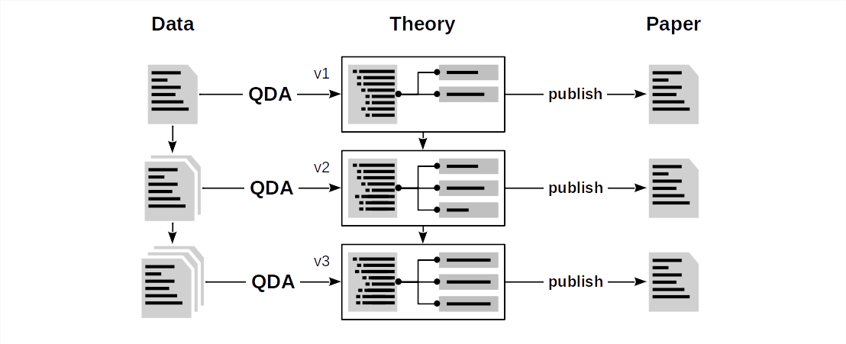
The Importance of Qualitative Data Analysis

Slide 32
5. Mixed-Methods Research

Slide 33
Mixed-Methods Research Design
A mixed-methods research design is a research design that
Combines qualitative with quantitative research methods

Slide 34
Example Mixed-Method Research Design
Novel programming language feature
Hypothesis creation
Jansen (2010): The qualitative survey
Hypothesis test
Ko et al. (2015): Controlled experiment
Theory building
Jansen (2010): The qualitative survey

Slide 35
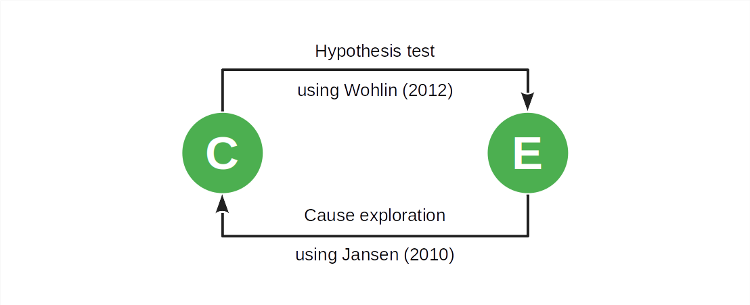
Causal Analysis / Correlation and Causation

Slide 36
6. Quality Assurance

Slide 37
Quality Criteria for Research Methods (Recap)
Intuition | Qualitative research | Quantitative research
Truth value | Credibility | Internal validity
Applicability | Transferability | External validity
Consistency | Dependability | Reliability
Neutrality | Confirmability | Objectivity

Slide 38
Trustworthiness
Credibility is
The degree of confidence in the truth of the findings
Transferability is
The degree to which findings can be transferred to another context
Dependability is
The degree to which findings are stable over time
Confirmability is
The degree to which the findings can be confirmed by other researchers

Slide 39
Establishing Quality (Not Assuring it)
Quality in qualitative research is “established”
Quality is proactively baked into the methods

Slide 40
Practices for Establishing Quality [1]
Credibility
Prolonged Engagement
Persistent Observation
(Different forms of) triangulation
Peer debriefing
Negative case analysis
Referential adequacy
Member-checking
Transferability
Thick description
Dependability
Inquiry audit
Confirmability
Confirmability audit
Audit trail
Triangulation
Reflexivity
[1] See Guba & Lincoln (1982): Naturalistic inquiry.

Slide 41
Summary
Theory building
Qualitative research
Example methodologies
Multi-method research
Mixed-methods research
Quality assurance

Slide 42
Thank you! Any questions?
dirk.riehle@fau.de – https://oss.cs.fau.de
dirk@riehle.org – https://dirkriehle.com – @dirkriehle

Slide 43
Legal Notices
License
Licensed under the CC BY 4.0 International license
Copyright
© 2012, 2023, 2024 Dirk Riehle, some rights reserved

